Slide 1
Analysis Of Demographic data of Washington, US
Using SAS
by Kumar Chamarty

Slide 2
Presentation Outline :
Background/Introduction
Objectives
Methodology
Conceptual Framework/Variables of the study
Descriptive Analysis
Hypothesis.
Results/findings
Conclusions
Summary and Recommendations
Appendix

Slide 3
Background:
The sample data set is a demographics dataset of Washington state, US.
The survey consists of a total of 6,726 house holds and a total of 17,967 people.
A total of 274 features have been captured for each household.
The sample survey was part of 2004 census and spread across 8 different regions..

Slide 4
Objective:
To study the demographics data and see if we can get any meaningful information out of it.
To analyse and determine if there is any relation between the features/variables.
Business Objective:
To analyse and determine the characteristics of homeowners
To Identify which regions are best to invest in the housing /real estate market – in particular, the construction Market.

Slide 5
Methodology :
Data
All the explanatory variables in our data set are either continuous or ordinal.
Our Target variable (household income) is a binary variable.
Lot of information such as number of dependents and household income and ownership status is DUPLICATED.
The dependents information is replicated in Children14, Children17, Children18 and Children20 columns.
Number of people contributing to household income information must be obtained from columns Q4P7, Q4P3, Q4P4, Q4P6
Missing values treatment:
HOMEOWNERS : Dropped the missing records
OTHER_INCOME_SOURCE : Dropped the column
NUMBER OF YEARS IN THE US: Missing data replaced with mean value.
AVG_EDU_LVL, NUM_IN_ARMY,: Missing data replaced with the mode.
Data cleaning:
Summarized all the data at Household level.

Slide 6
Methodology contd….
Outliers. Outliers were detected in household Income were removed by dropping those records.
Feature engineering:
Most of the columns had to be derived from multiple columns.
Our Target Variable (Homeowners) consisted of other information such as renters and neither.
Modeling: Used Logistic Regression as our target variable is a binary classification. Gathered info on

Slide 7
Methodology contd….
SAS procedures used to accomplish.
PROC SQL was used to achieve most of the data manipulation and Feature Engineering.
PROC SGPLOT was used for visualizations.
DATA STEP was used to Manipulated row-wise data.
PROC STDIZE to standardize the variables ( option method=std)
PROC SURVEYSELECT to get our training set.
PROC LOGISTIC (Logistic Regression) was used to build our model to answer our business question.

Slide 8
STUDY FRAMEWORK
Region
Age
NUMER OF YEARS IN US
Highest Education Level
Number of people in the household
Children <14
Children<17
Children <18
Children <20
Home owners
Number of dependents
Whether they are currently employed
Did they work in farm or receive any profits from business
Household Income
Number of employed people per household
currently serving in the army previously served in the army.
Served In the Army or Not

Slide 9
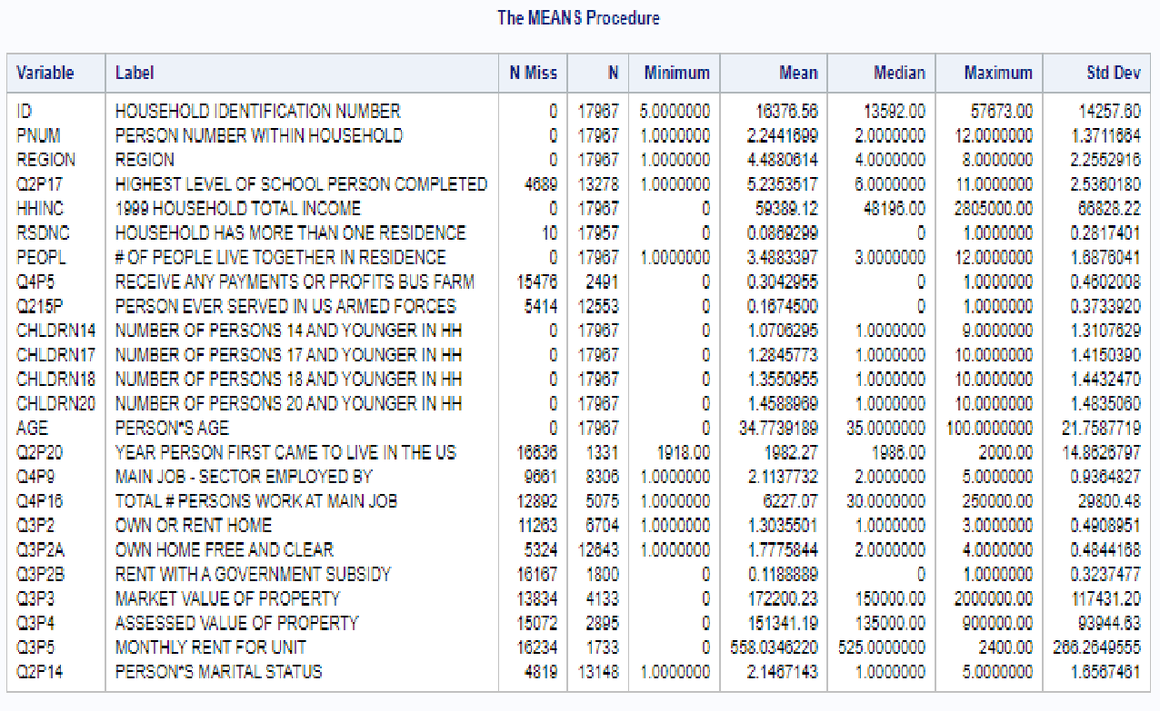
Summary of Initial Study Framework

Slide 10
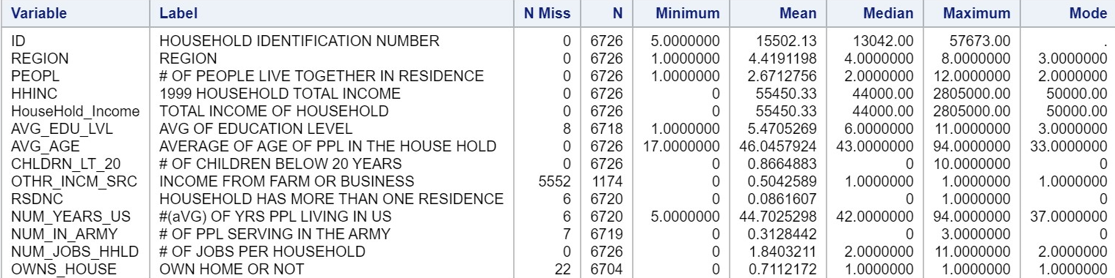
Summary of my final study framework

Slide 11
The distribution of Average Age of all the People in the Households.

Slide 12
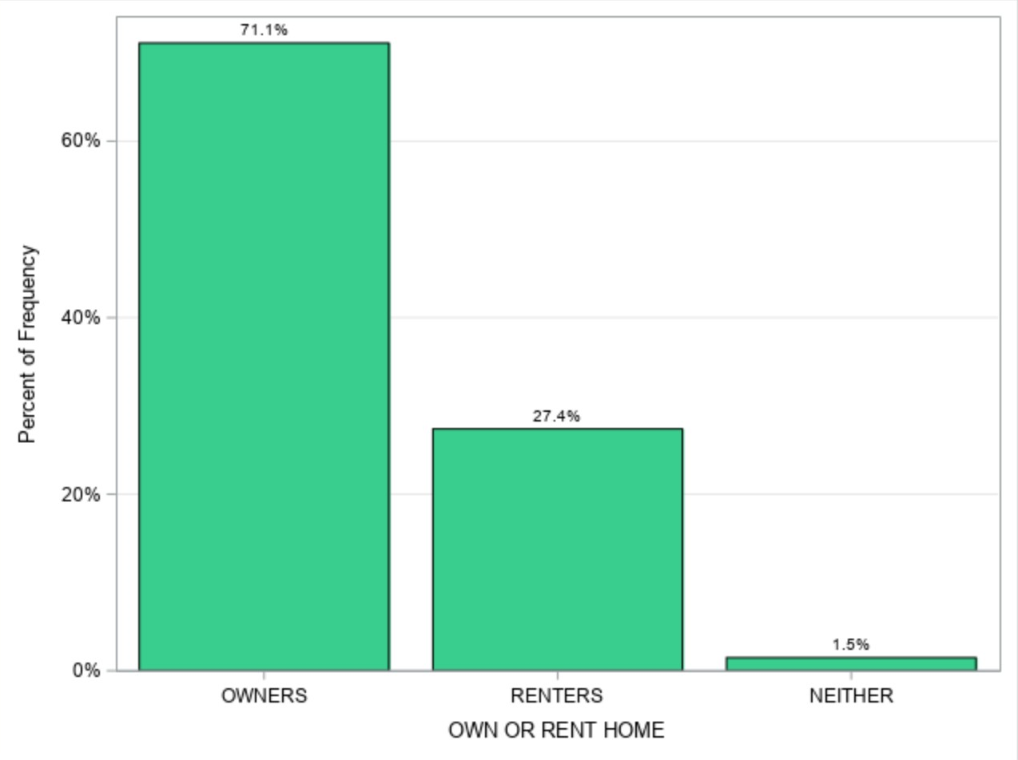
Frequency Distribution of Residence status:

Slide 13
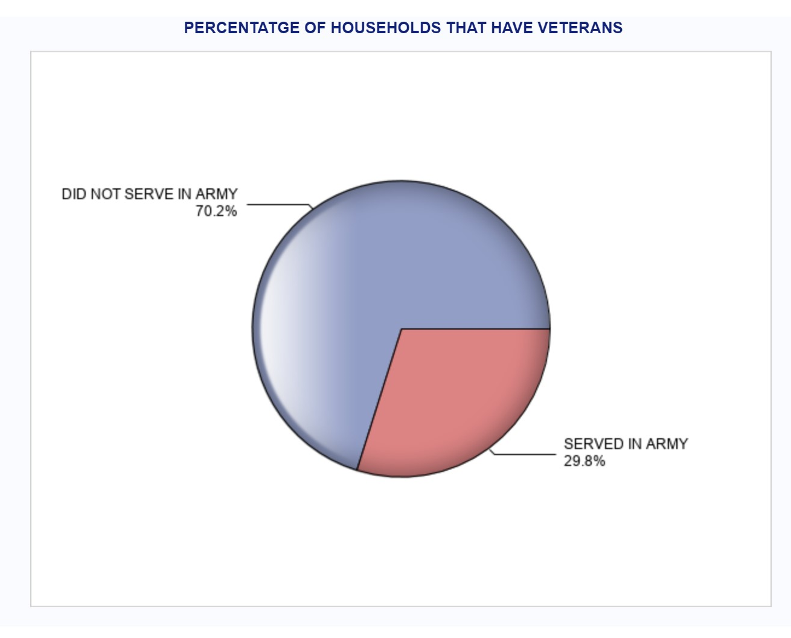
How Many of the Households have members that are currently serving or have previously served in the US Army?

Slide 14
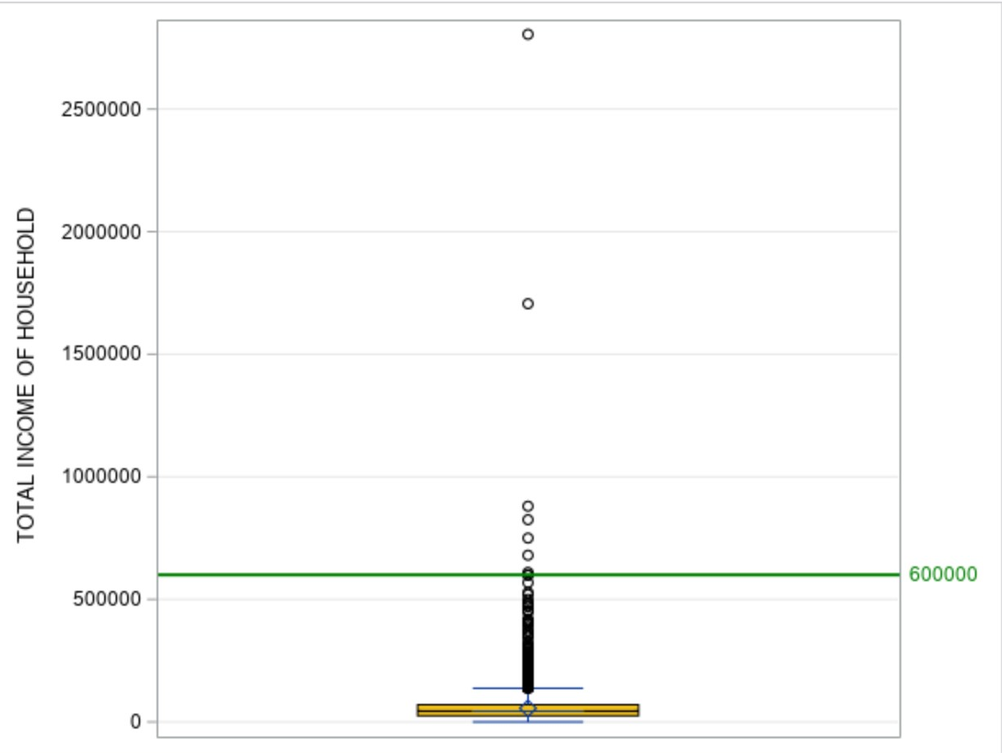
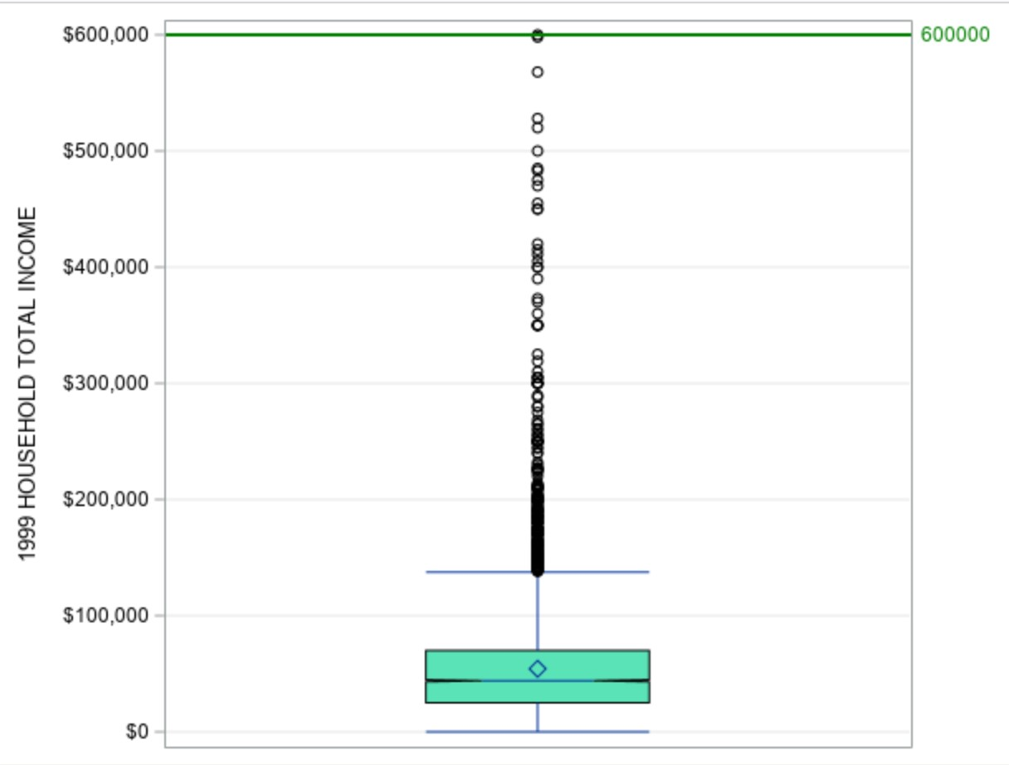
Household Income Analysis (outlier detection)

Slide 15
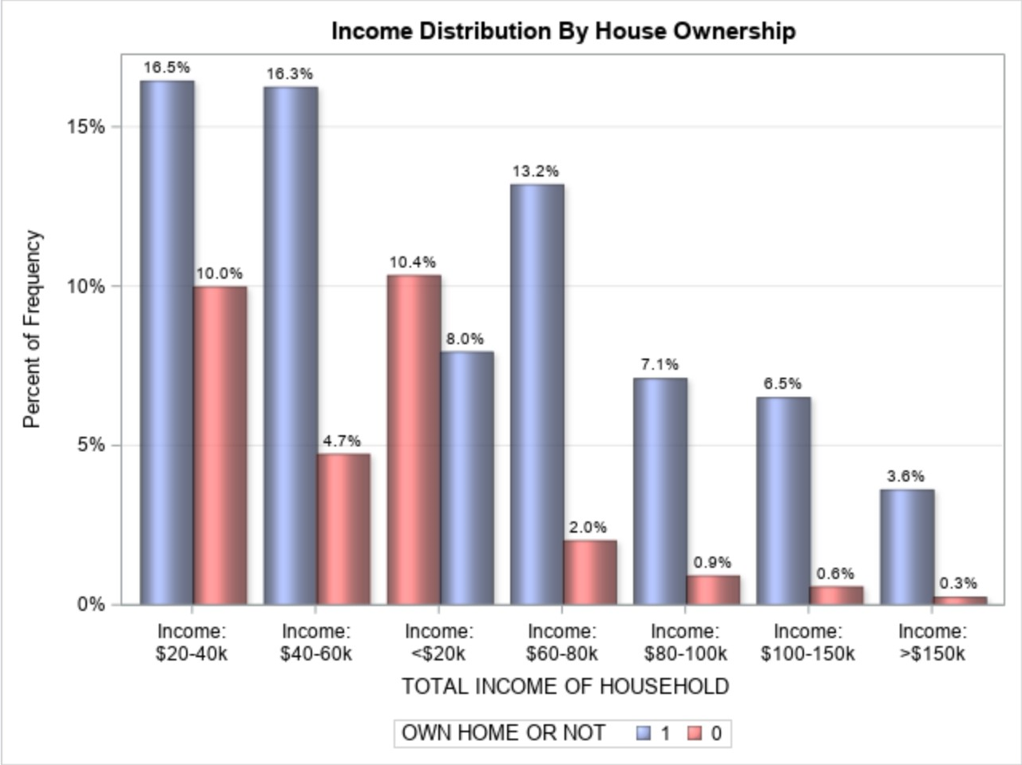
Household Income vs Home Ownership Analysis:

Slide 16
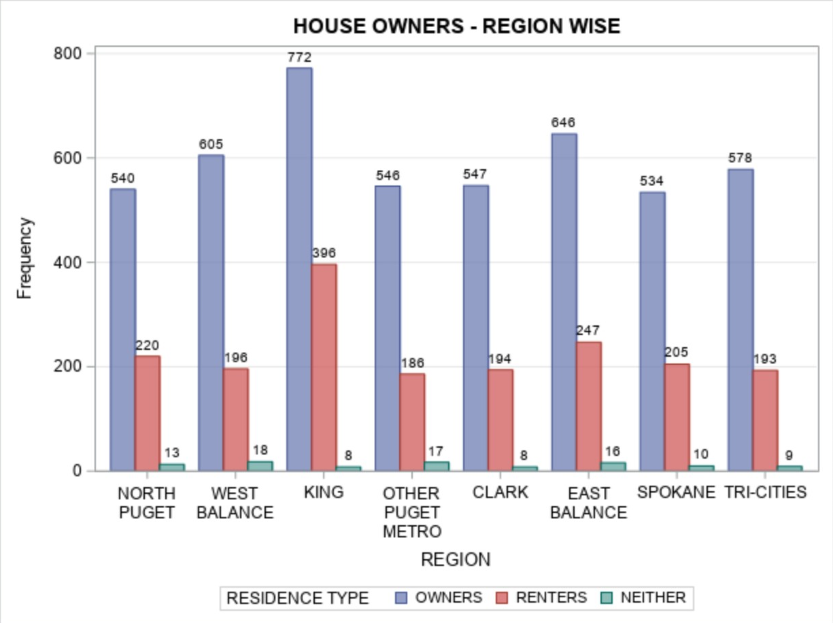
DISTRIBUTION OF RESIDENCE TYPE BY REGION:

Slide 17
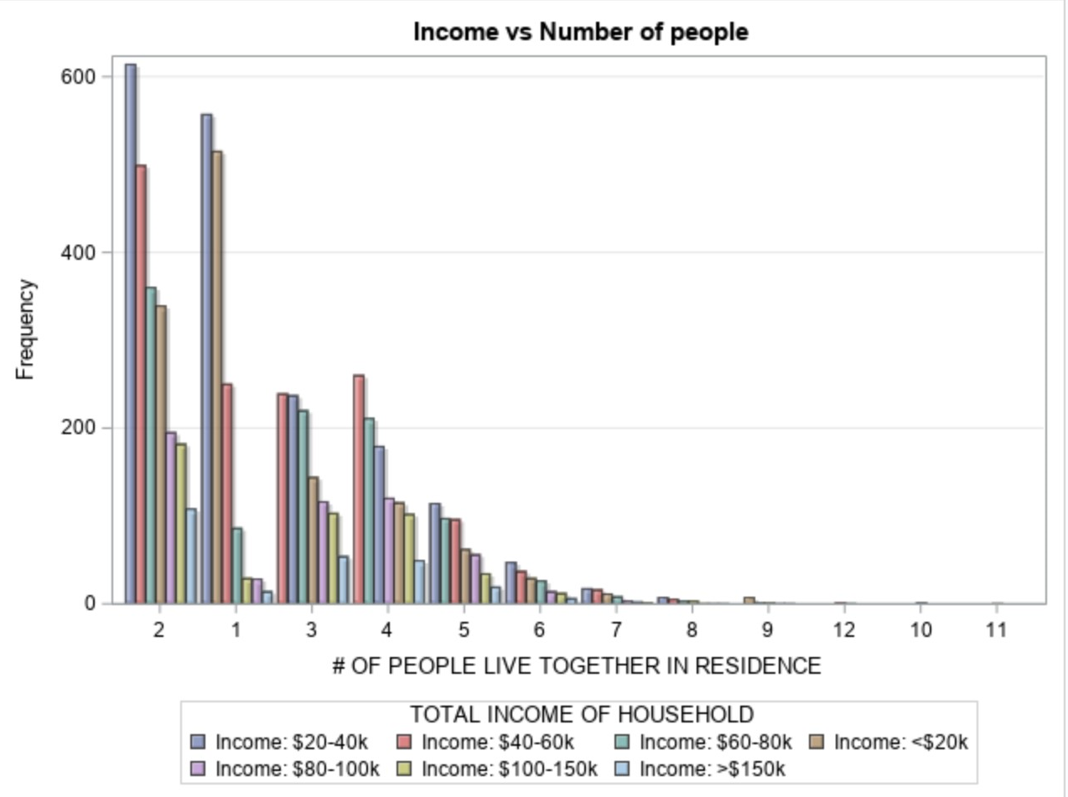
Do a greater number of adults in a household contribute to more income?

Slide 18
Hypothesis Question(s):
Home Ownership is correlated to
Household Income
Average Age of People in the Household.
Number of years the people have lived in the states.
Number of dependents
Number of people in the household.
Number of people

Slide 19
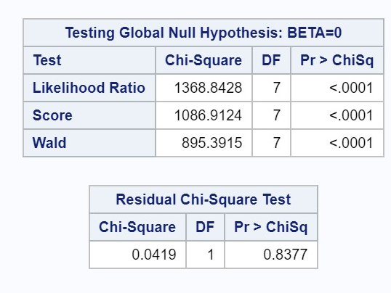
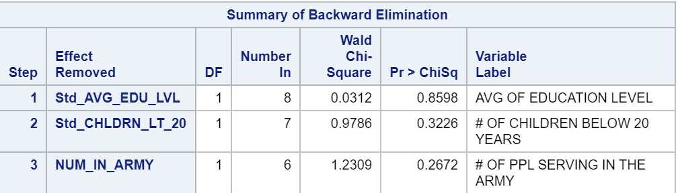
Results & Findings through Logistic Modeling
Initial P statistic of all the features indicates that the correlation with our Target (Homeowners) is very low (p>0.83).
Average Education Level of people in the household, number of dependents and households having people serving in the army do not seem to have any impact on the Home ownership. And are therefore removed from our model.
On the other hand, Household Income, Number of years peopled have lived in US, Average Age of people in Household and number of employed persons in the family.

Slide 20
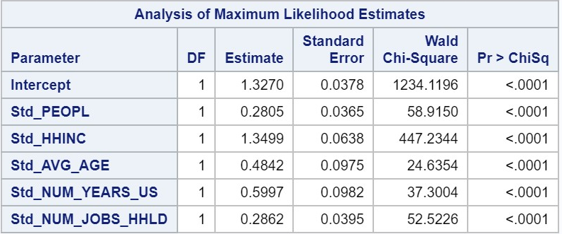
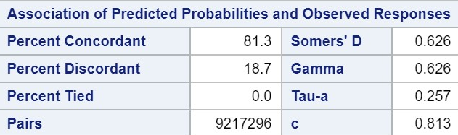
Model Prediction and scores.
From the estimates,
HomeOwners_Prediction = 1.3270 + 0.2805*Std_PEOPL + 1.3499*Std_HHINC + 0.4842*Std_AVG_AGE + 0.5997*Std_NUM_YEARS_US + 0.2862*Std_NUM_JOBS_HHLD
The ROC of our model is 81%

Slide 21
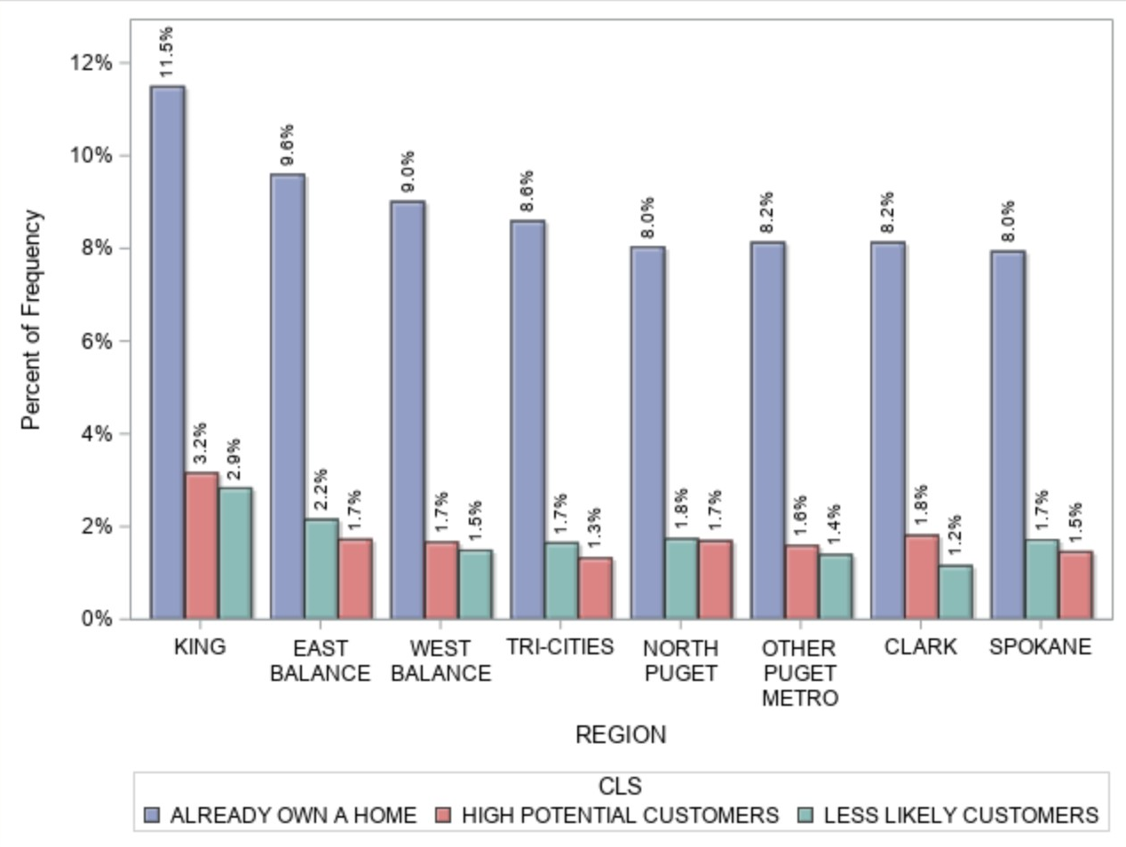
CONCLUSION:
AS PER OUR MODEL,
KING REGION HAS THE HIGHEST POTENTIAL FOR HOME BUYERS.
EVEN THOUGH KING ALREADY HAS A HIGH PERCENTAGE OF HOMEOWNERS, IT ALSO HAS THE HIGH ST %OF POTENTIAL CUSTOMERS

Slide 22
Summary and Recommendations:
We can create a logistic regression model that predicts house ownership with 81.3% probability.
But , In order to get better results, we need to gather more samples and fish around for more features such marital status and whether they have retired or not.
There are few households that have very high income and still do not own a home. We need to investigate further to see if we can find a plausible reason for this situation.
We need to explore other modelling and analysis techniques to get better accuracy.

Slide 23
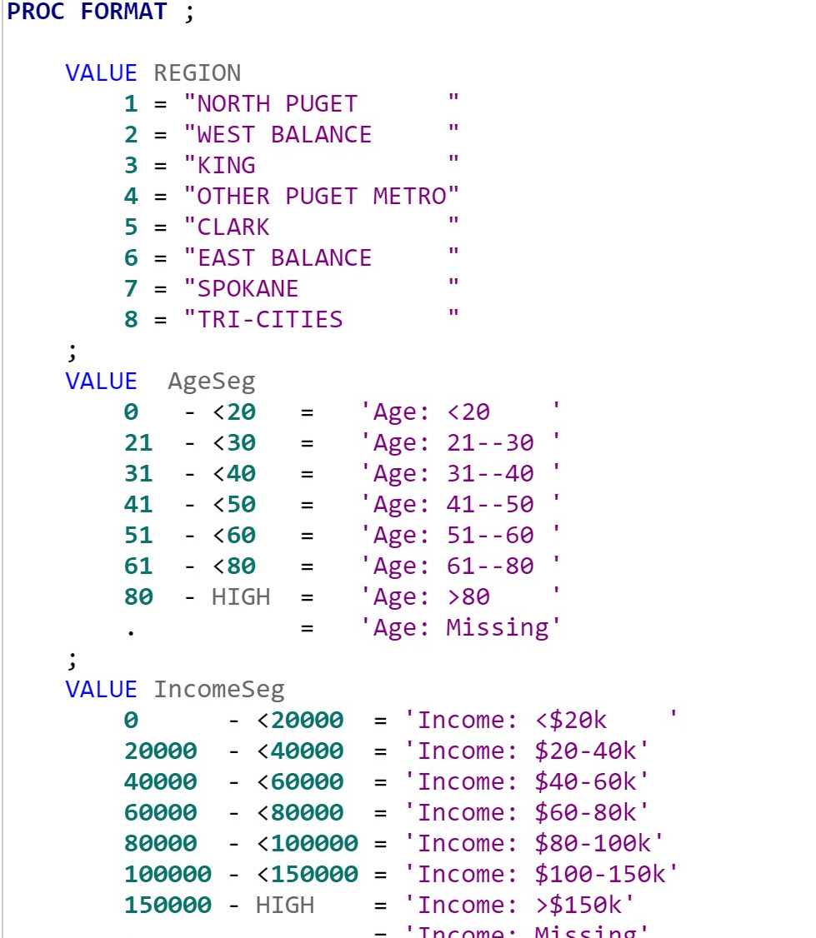
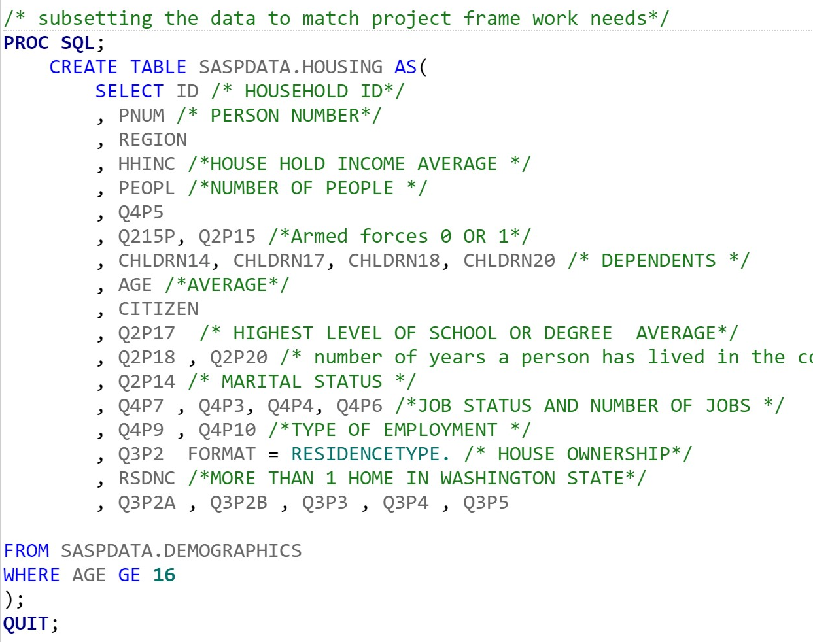
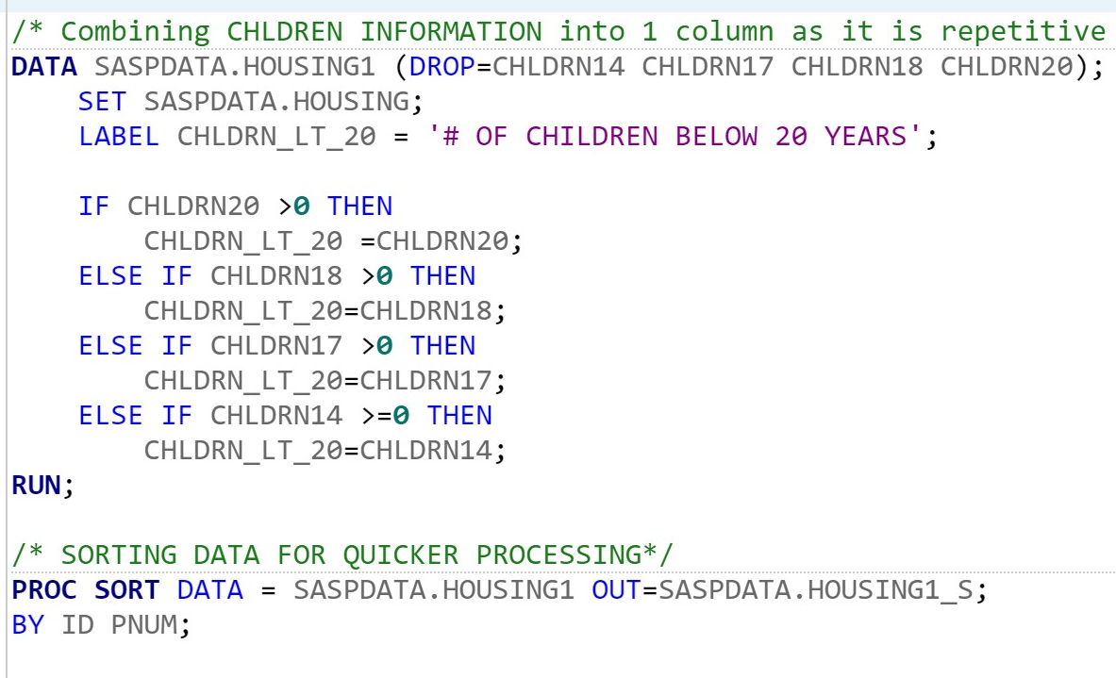
Sample Codes: Formatting and initial Study Framework

Slide 24
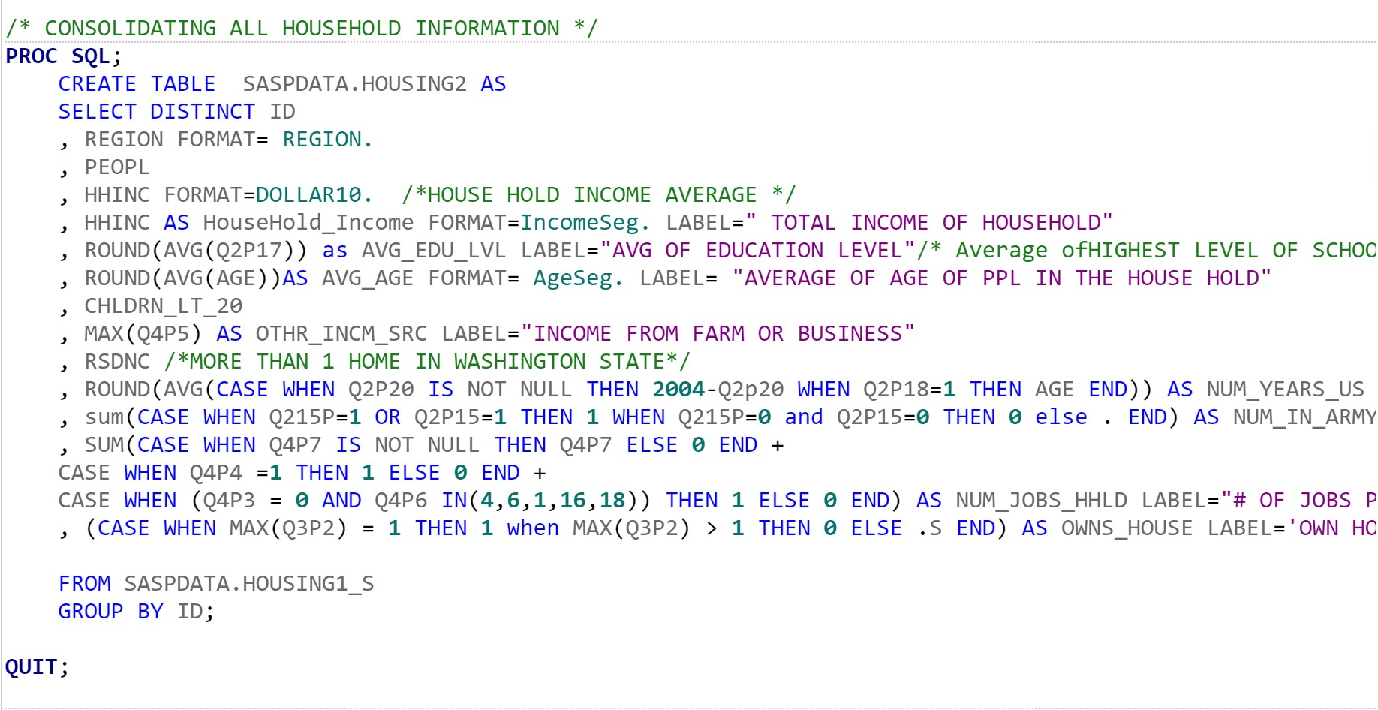
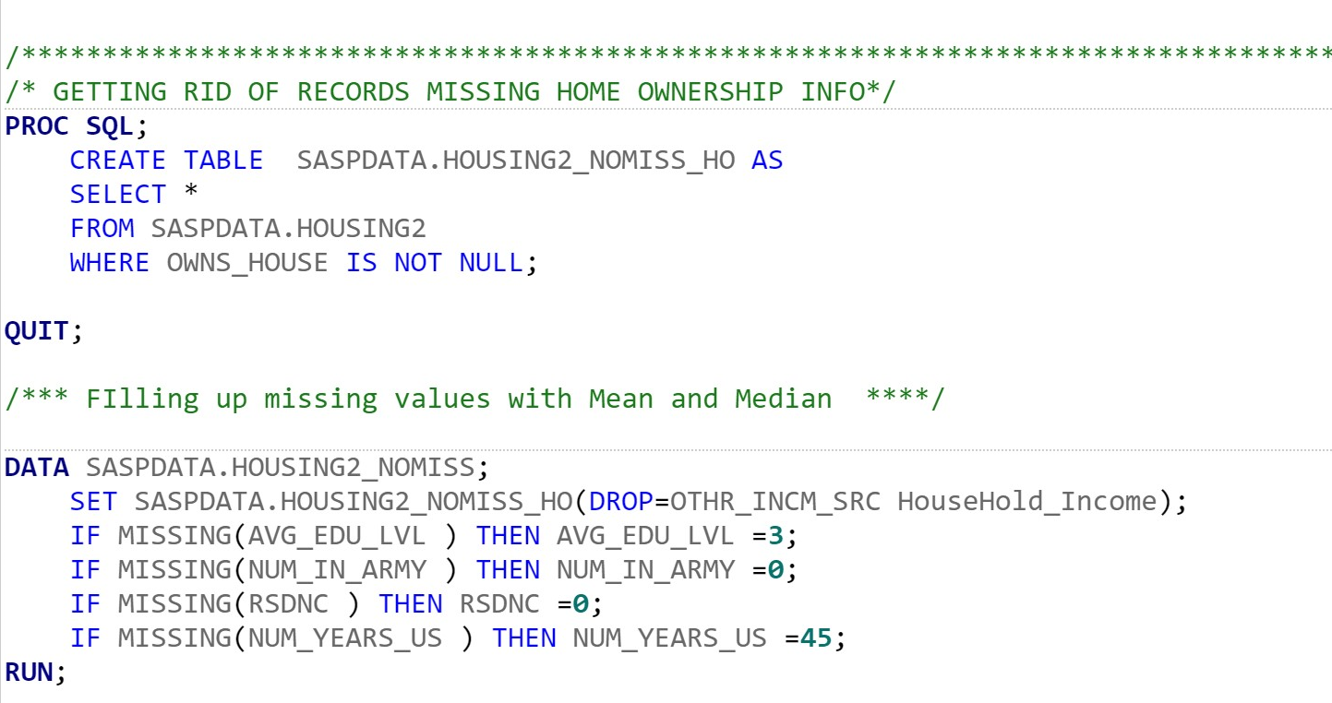
Sample Codes: Final study Framework and Missing values treatment

Slide 25
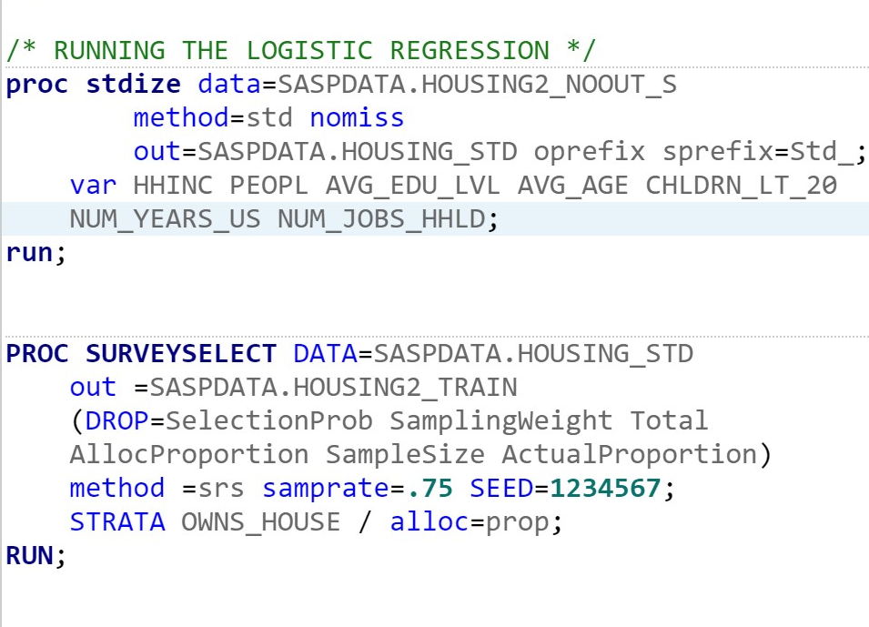
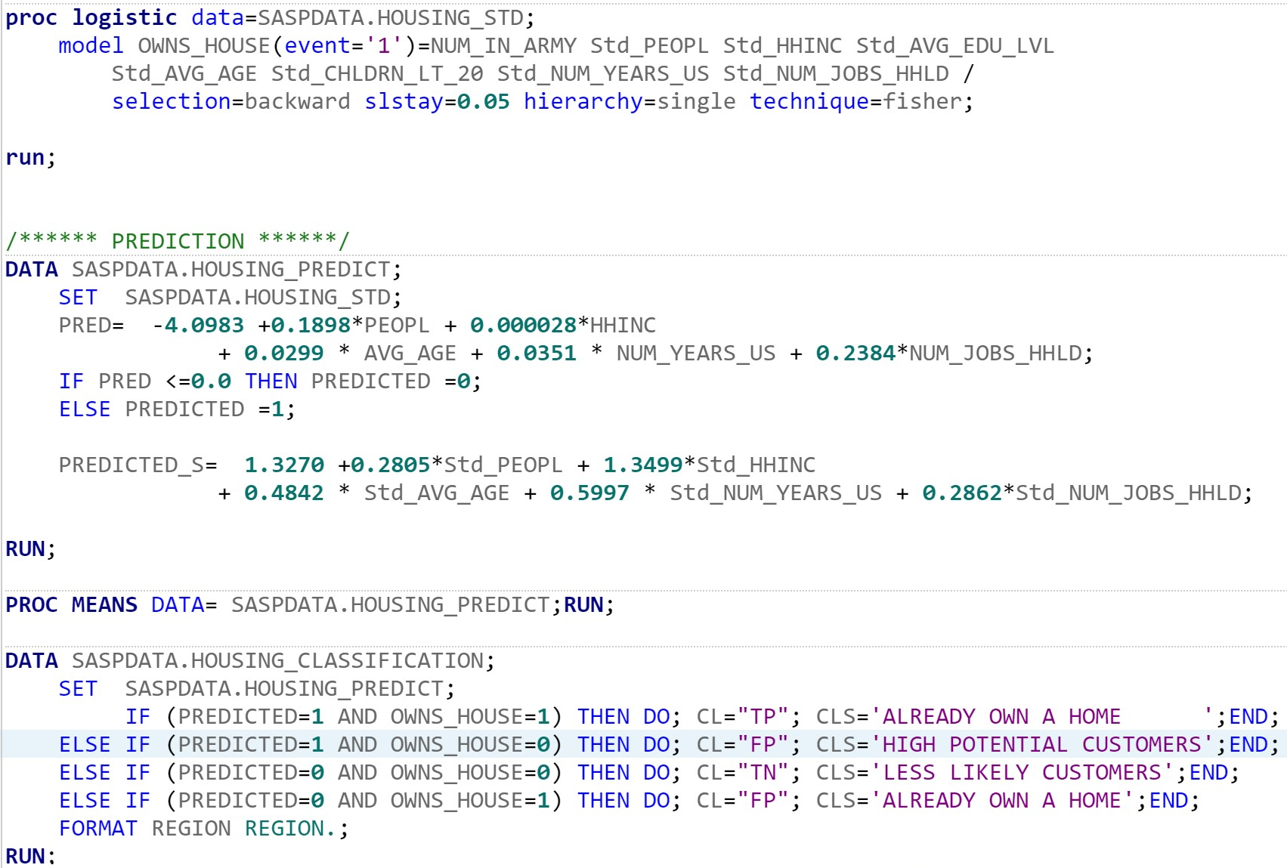
Sample Codes: standardizing and modelling

Slide 26
Q&A…?
Thank you…

